Slide 1
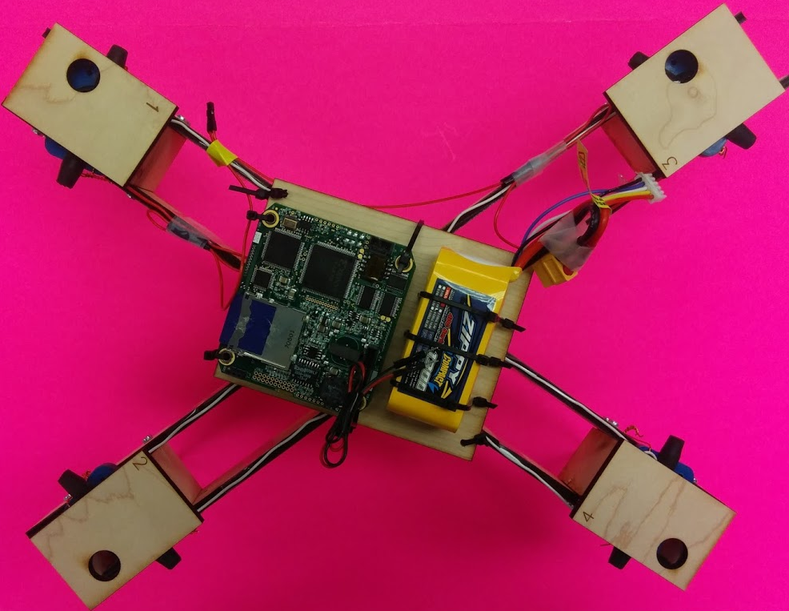
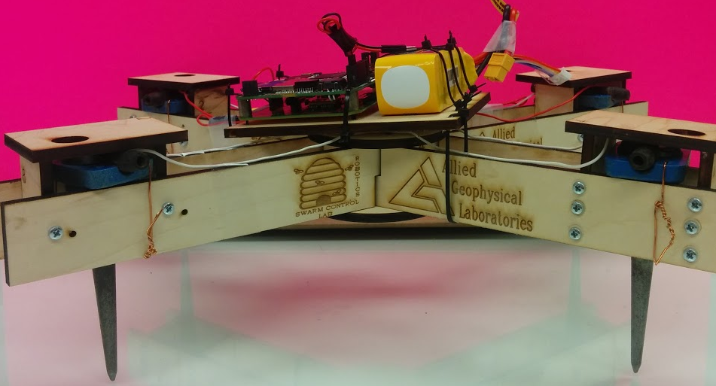
Geospace Seismic Recorder (GSR)
Battery
Geophone Sensors
with spikes

